Slide 1

UNIVERSITY OF PETROLEUM & ENERGY STUDIES
School of Computer Science
Dehradun
COURSE: IT Security
July – December 2023
Delivered by
Dr. Gopal Singh Rawat
1

Slide 2
Course Plan
Introduction to IT System Security
Operating System Security
End Point Security
Application Server Security
Database Server Security
IT System Security Processes

Slide 3
Unit #2: Operating System Security

Slide 4
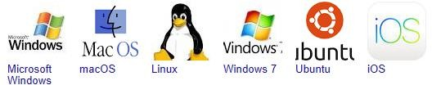
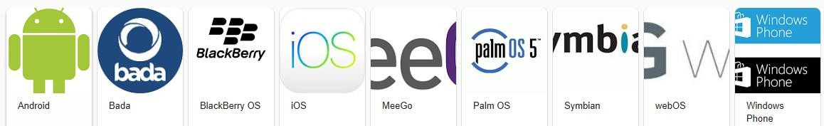
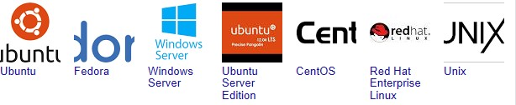
2.1 What is an Operating System:
Software that manages computer hardware (Processing, Memory, Storage etc.) resources and software.
Provides GUI interface between the user and hardware system without the user knowing how to ‘speak’ 0s and 1s.
Provides services for Computer and its Programs to run – AD (authentication) File transfer (storage), DNS (hosting), Computing (Memory, Processing, Storage).
Examples of Desktop/Laptop OS:
Examples of Mobile OS:
Examples of Server OS:

Slide 5
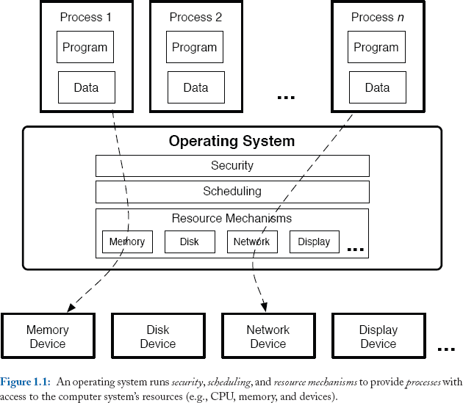
2.2 Operating System Functions:

Slide 6
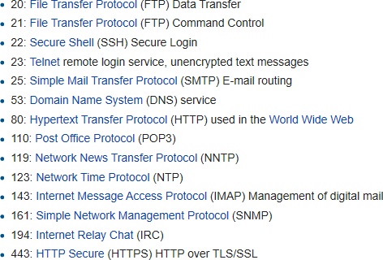
2.3 Why is it difficult to secure an Operating System:
OS cannot defend themselves against IT or Cyber attacks. They have to be patched / updated.
Hardware (Physical) / Software (Logical) Ports are difficult to secure – these are end point of external communication
Physical ports – attach hardware devices like USB, Serial, Network cables
Logical Ports – connect to external communication sessions
Logical Port Ranges:
System Ports: 0 - 1,023
0 – 63: Network related
64 – 127: Host specific
128 – 239: Future Use (reserved)
240 – 255: Experimental (reserved)
Registered Ports: 1,024 - 49,151
Dynamic Ports: 49,152 – 65,535
Well Known Ports:
Notes:
https://www.iana.org/assignments/service-names-port-numbers/service-names-port-numbers.xhtml

Slide 7
2.4 OS Operations involves three major tasks:
#1 Operating systems must provide efficient resource mechanisms,
#2 Operating system’s responsibility to switch among the processes fairly
#3 Control access of system resources → so that one process cannot inadvertently or maliciously impact execution of others.
This Task #3 is the problem of ensuring the security of all processes run on the system.
Problem is how to ensure the secure execution of all processes is correct?
How to ensure implementation of resource and scheduling mechanisms is fair?
Sharing of data among processes and users needs to be controlled / secured
The output of one process may be used by other processes.
With use of Internet sharing applications like email, web or instant messaging → users may share anything with anyone in the world

Slide 8
2.5 Security Goal: Design a Secure Operating System
Provides security mechanisms that ensure the system's security goals are enforced despite the threats faced by the system.
Security goal describe show the operating system implements accesses to system resources that satisfy –
Secrecy
Integrity
Availability
Security Goals:
Principle of Least Privilege (PoLP)→ Limits a process to only the set of operations necessary for its execution.
Separation of Duties (SoD) → Prevents fraud, sabotage, theft, security compromises.
Need to know Basis

Slide 9
2.6 How to secure an Operating System: two models →
Trust Model
Threat Model
Trust Model
A system’s trust model defines the set of software and data upon which the system depends for correct enforcement of system security goals.
Given a set of software, including the security mechanisms - these must be (have to be) trusted and allowed access
E.g. Operating System depends on a variety of programs to authenticate the identity of users (e.g., login and SSH).
Threat Model
Defines set of operations that an attacker may use to compromise a system.
An attacker is said to have compromised an system → if he is able to find a vulnerability in the system that
provides access to secret information → violates secrecy
permits the modification of information that subjects depend on → violates integrity
This threat model exposes a fundamental weakness in commercial operating systems
It is assumed that all software running on behalf of a subject is trusted by that subject .
This can result in the leakage of that user’s secrets and the modification of data that the user depends on.

Slide 10
Access is the flow of information between a subject and a resource.
Subject is active entity that requests access to a resource or the data within a resource. E.g.: user, program, process etc.
Resource is an entity that contains the information. E.g.: Computer, Database, File, Program, Printer etc.
2.7 Features of IT Security:
Access Control
Network Access Control

Slide 11
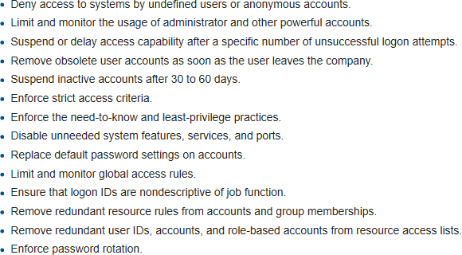
2.7.1 Access controls
Concerned about security control on how users and systems communicate and interact with systems and resources.
Goal is to minimize the risk of unauthorized access to physical and logical systems.
Access Control criteria for providing access to an object →
Roles
Groups
Location
Time
Transaction Type
Access Control Practices

Slide 12
2.7.2 Network Access Control (NAC):
Attempts to unify endpoint security technology (such as antivirus, host intrusion prevention, and vulnerability assessment), user or system authentication and network security enforcement.
NAC Practices:
Centralized Policy Management - instead of multiple systems to manage different types of users, use one centralized system to review (see) where Corporate Users, Guests, and Contractors are allowed to go.
Dashboard Device Profile Views - device profiling
What types of devices are being used on your wireless network or wired network?
Where are they connecting from?
Gather Usage statistics and device details → take future network and policy decisions
Self-Registration of BYOD Devices - Device Registration for BYOD should allow users to provision their own devices.
Secure Guest Registration & Access - This means the user is allowed to register with a captive portal and the system
will not provide a password to be shared around the office.
Remote Registration & Auto-provisioning of devices - BEFORE user gets to campus, register and auto-provision their devices

Slide 13
2.8 Major types of Operating System Threats:
Hardware based attacks
Device independent attacks
Software based attacks
User based attacks

Slide 14
2.8.1 OS Threat: Authentication Issues
Refers to identifying each user of the system and associating the executing programs with those users.
OS responsibility to create a protected secure system which ensures that a user who is running a particular program is authentic.
Operating Systems generally identifies/authenticates users using following ways.
Username / Password −
Enter a registered username and password with OS to login into the system.
Its “something you know”
User Card / Key −
punch in card or enter key generated by key generator to login into the system.
Its “something you have”
User attribute –
Fingerprint / Retina pattern / Signature −
Provide personal attributes via designated input device used by operating system to login into the system.
Its “something you are”

Slide 15
2.8.2 OS Threat: One Time Passwords
One Time Passwords (OTP) provide additional security along with normal authentication.
Here a unique password is required every time user tries to login into the system.
Once an OTP is used, then it cannot be used again.
One-time password are implemented in various ways.
Random numbers −
Users are provided cards having numbers printed along with corresponding alphabets.
System asks for numbers corresponding to few alphabets randomly chosen.
Secret key −
User are provided a hardware device which can create a secret id mapped with user id.
System asks for such secret id which is to be generated every time prior to login.
Network password −
Some commercial applications send one-time passwords to user on registered mobile/ email which is required to be entered prior to login.

Slide 16
2.8.3 OS Threats: Program or Application level Threats
OS’s processes and kernel perform designated task as they are instructed.
If a user program made these process do malicious tasks, then it is known as Program or Application level Threats.
Example: Program installed in a computer which can store and send user credentials via network to some hacker.
Following is the list of some well-known program threats.
Trojan Horse − Such program traps user login credentials and stores them to send to malicious user who can later on login to computer and can access system resources OR downloads other malicious codes.
Trap Door − If a program which is designed to work as required, have a security hole in its code and perform illegal action without knowledge of user then it is called to have a trap door.
Logic Bomb − Situation when a program misbehaves only when certain conditions are met, otherwise it works like a genuine program. It is harder to detect.
Virus − Virus as name suggest can replicate themselves on computer system and modify/delete user files, crash systems. A virus is generally a small code embedded in a program. As user accesses the program, the virus starts getting embedded in other files/ programs and can make system unusable for user
Spyware – Program installed on user system that obtains information in covert manner → Adware, Cookies, Key Loggers
Rootkits – activated when system boots, before anti virus/anti malware starts. These install files and accounts for the
purposes of intercepting sensitive information.

Slide 17
2.8.4 OS Threats: Operating System level Threats
System threats refers to misuse of system services and network connections to put user in trouble.
System threats can be used to launch program threats on a complete network called as program attack.
System threats creates such an environment that operating system resources/ user files are misused.
Following is the list of some well-known system threats.
Worms −
Process which can choke (clog) system performance by using system resources to extreme levels.
Worm process generates its multiple copies where each copy uses system resources, prevents all other processes to get required resources.
Worms processes can even shut down an entire network.
Port Scanning −
Port scanning is a mechanism or means by which a hacker can detects system vulnerabilities to make an attack
on the system.
Lab → Tripwire → vulnerabilities & % of system being secure
Denial of Service (DoS) −
Denial of service attacks normally prevents user to make legitimate use of the system.
User may not be able to use internet if DoS attacks browser's content settings.
UDP Flood
ICMP (Ping) Flood
SYN Flood
Slowloris
HTTP Flood.

Slide 18
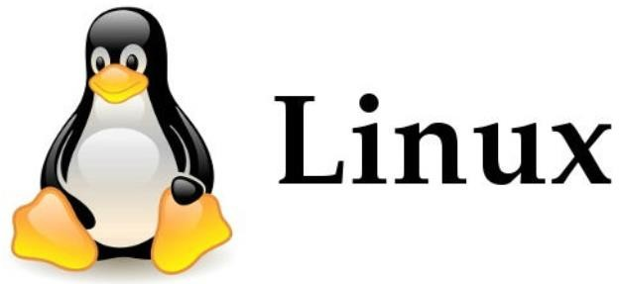
Four A’s of IT System Security:
Authentication –
verifying the identity of the user requesting the access → Legitimate user
Authorization –
provide appropriate level of access to the authenticated user
Administration –
Task and activities associated with maintaining the user access and activities
Audit –
activities performed to satisfy compliance – rules / best practices / standards being followed
2.9 Unix and Linux Operating System Security
Application Programming Interface (API)
Enable programmers to write applications
APIs are compatible with multiple platforms and Kernel (base program) interacts to perform interface, access and activity
APIs →common platform → shared by several users → Security problem
Security Issues for Multiple Unix and Linux system:
Account Security – concerned with levels of user accounts → Password security,
Network Security – unauthorized access to system → Telent, FTP, Remote, Modem/LAN Access
File System Security – preventing unauthorized access to files and data → NFS
Privilege Access Management – difficult with native capabilities → over and over again for each system
Managing Identities and Access for multiple Unix system → complex and inefficient → each Unix – disjointed / island

Slide 19
2.9.1 Types of User Accounts:
Standard User – given access, permissions and authorization
Super User –
ROOT – prebuilt with every Unix / Linux system
Allows you to almost anything on the system & Ignores file permissions → Privilege account
Capabilities –
Have Read / Write / Execute access
Perform install, modify, delete or run programs
List passwords circulating in an organization
List passwords that have never been changed / reset
List non-functional IDs → employees who have left
Change job and roles or accounts
Copy and share SSH Keys
Risk → Insider Threat → Separation of Duties
Solution → Least Privilege – restrict access to critical server and data, reduce risks
Risk to organization – financial, reputation, regulatory, customer loss
Each File and Directory in Unix / Linux is marked with three set of file permissions →
Owner
Group
All Others
Each set may have none or more permissions for each item → Read, Write, Execute

Slide 20
2.9.2 Unix File System example
Each file is associated with:
An owner UID and an owner GID
Process with the owner UID privilege can modify the protection state
“mode bits” describe the ACL of a file
{owner bits, group bits, others bits} → where each element consists of a read bit, a write bit, and an execute bit
e.g.
-rw-rw-r--
-rw-rw-r--
-rw-rw-r--
1 simon
1 user1
1 user2
faculty faculty students
14 Sep 8 03:59 file1
14 Sep 8 04:04 file2
14 Sep 8 04:04 file3
“simon” belongs to group “faculty” “user1”, “user2” belong to group “students”
-r-------- | 1 simon | faculty | 14 Sep | 8 03:59 file1
----r----- | 1 user1 | students | 14 Sep | 8 05:01 file2
-------r-- | 1 user2 | students | 14 Sep | 8 05:02 file3

Slide 21
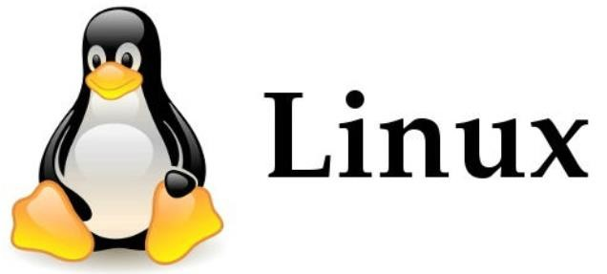
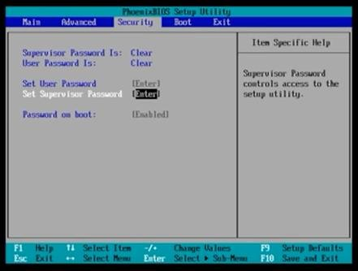
2.9.3 Unix / Linux OS Hardening Checklist
Improve the security level of systems
#1 Physical Security
Physical access to Unix / Linux server → plug out power / network / display / storage cables
Trained Engineers and Trusted personnel allowed only
Reboot and enter using Single User Mode → reset root password OR boot with USB and reset passwords
BIOS Security → BIOS Password → Lowest level

Slide 22
2.9.3 Unix / Linux OS Hardening Checklist
#2 System Security
Note down system details
System’s Name, IP Address, MAC Address, Location, Network Port #
Install System for Security Updates and Patches → for yum, apt, etc.
root@system:~# apt-get install unattended-upgrade
dpkg-reconfigure --priority=low unattended-upgrades
Set up Firewall, Disk Encryption Strong passwords
Disable USB and Peripheral devices / ports
Perform Service Hygiene →
Bind services/processes to localhost (127.0.0.1)
Disable → init.d, xinetd, FTP
Perform System Account Hygiene →
Create a non-root user for daily use
Remove any unused accounts
Disable shell or elevated access for standard/built-in users
Disable logon as root
Enable System and Event logging

Slide 23
2.9.3 Unix / Linux OS Hardening Checklist
#3 Logical Security
Install Antivirus
Setup IDs/IPS (Intrusion Detection System / Intrusion Prevention System)
Separate disk partitions –
/usr, /home, /var & /var/tmp, /tmp
Run only one network service per system
Setup System monitoring –
Access, Uptime, Configuration changes → Logs
Schedule backup of log files and lock down directory storage
Perform System Audit

Slide 24
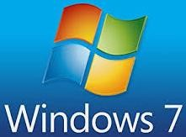
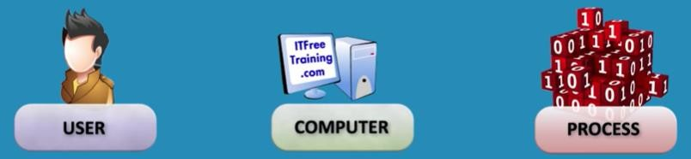
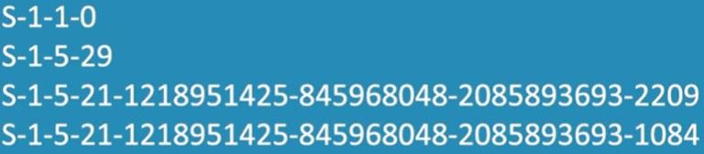
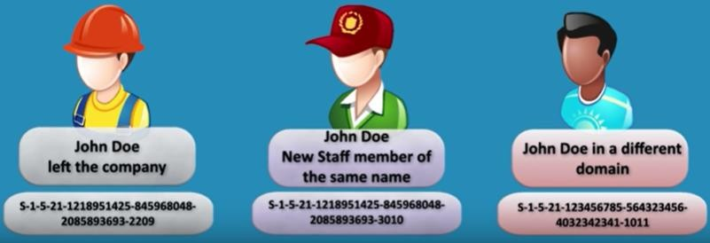
Windows Operating System Security
Security Principle
Someone who is asking for access
Entity that can be authenticated
Everyone has a Security Principle
Security Identifier (SID)
Unique number associated with an entity
Every Security Principle has a SID and can be renamed
Uniquely identify new objects even if they have a name
Always initially DISABLE user instead of deleting them
Local → non-domain SIDs
External→ Domain SIDs

Slide 25
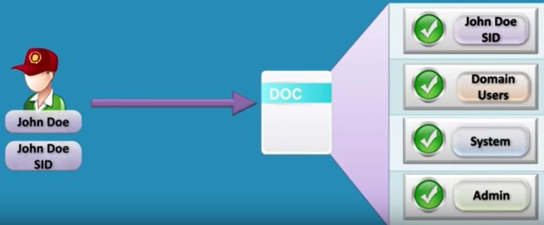

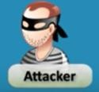

2.10.3 Access Control List →
Control the Entry/Exit access
Depending on the SID →
Access to system
Access to Domain – user
Access to Server folder and file
Permissions for Read/Write
wants to access Doc file
Security violation → Threat

Slide 26
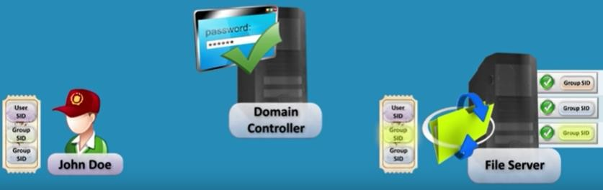
2.10.4 Access Tokens →
Has security context of that entity
This uses SID, Permissions, Group Membership to validate access
Digital Signatures, Tokens

Slide 27
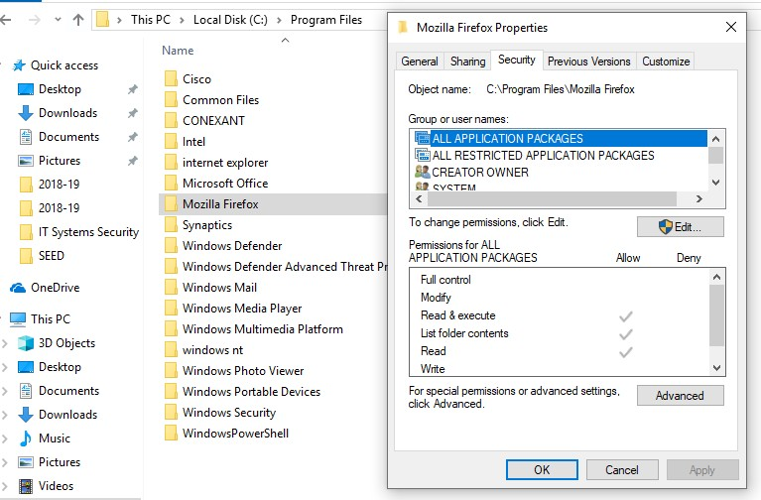
Real World →
Properties of any folder – displays access groups and permissions

Slide 28
2.11 Windows OS Hardening Checklist
#1 Physical Security → Managing Physical Server Access
#2 System Security
Minimize External Footprint →
Install inside secure network
Access only via Intranet → jump/access to new server
Examine external access options → VPN only access
Restrict via IP address / hosts → Whitelist or Blacklist entities
Put behind hardware Network Firewall or Web Application Firewall (WAF)
Patching →
keep OS, Applications, Browser, Plugins updated → reduces vulnerabilities
Minimize Attack Surface
Disable and uninstall unnecessary services
Remove applications not required
Perform Audit
Access permissions and changes – know what is happening
Maintain server logging, mirror logs to another system

Slide 29
2.11 Windows OS Hardening Checklist
#2 System Security
Minimize User Access Permissions
Group permissions by Role
Limit User Account Access
Elevated permissions only as-needed
Delete unnecessary OS default users
Strong passwords
Password Policy –
Change every 30 – 60 - 90 days
No reuse of passwords
Log accounts after 5 failed attempts
Regularly scan for user names like ‘guest’, ‘admin’, ‘administrator’
Maintain Backups

Slide 30
2.12 Mobile and Operating System Threats & Vulnerabilities
Trojans
Trap Doors Logic Bombs
Malware
Virus
Spyware
Rootkits
Mobile & System OS Threats
Fileless
Device or Hardware based
Vendor - OS / App based
Types of Vulnerabilities
Device hardware - profiling
Zero Day Attack
User based – profiling

